Slide 1
3GPP TR 36.885 v14.0.0 3rd Generation Partnership Project;
Technical Specification Group Radio Access Network;
Study on LTE-based V2X Services;
(Release 14) PC5-based V2V, V2I Channel model Urban case
September. 15. 2021
Donghee Han
dhh0425@sogang.ac.kr

Slide 2
Contents
Terminology
시나리오 및 하이퍼 파라미터 값 선정
생성 순서도
순서도 별 참고 테이블(하이퍼 파라미터) 및 공식
테이블 공식에 따라 적용하여 생성했을때 값 및 그래프
최종 데이터 및 그래프
향후 응용 방법(V2V DQN 논문)
Development Environment
Reference

Slide 3
Symbols
■ PC5 : 이동 핸드세트가 무선 채널을 통해 다른 UE와 직접 통신하는 인터페이스.
(C-V2X에서 PC5 인터페이스는 V2V 및 V2I의 직접 통신으로 사용.)

Slide 4
시나리오 및 하이퍼 파라미터 값 선정
Parameter |  | Assumption
Carrier frequency |  | - PC5 based V2V : 6 GHz, 2 GHz - V2I : 6GHz (Baseline) for UE type (RSU), 2GHz for eNB type RSU
Bandwidth |  | - PC5 based V2V : 10 MHz - V2I : 10MHz for UE type RSU, 10MHz for each of Down link and Up link in FDD, 20MHz in TDD for eNB type RSU - V2P : 10 MHz is baseline
Number of carriers |  | - One carrier is baseline
Vehicle UE, UE type RSU, Pedestrain UE paraters | Antenna height | -1.5m for vehicle UE and pedestrain UE - 5 m for UE type RSU
 | Antenna gain | - 3 dBi for vehicle UE and UE type RSU - 0 dBi for pedestrain UI
 | Antenna pattern | Omni 2D
 | Maximum transmit power | 23 dBm
 | Noise figure | 9 dB
Notes:
3GPP TR 36.885 V14.0.0 (2016-06) p62
Table A.1.1-1: Details of evaluation scenarios

Slide 5
생성 Block diagram(Urban case)
Create
Road
Drop vehicle, base station
(position)
Vehicle-to-vehicle channels are updated during the simulation as follows:
- Let N be the number of vehicle UE in system simulation
- Initialization (at time 0)
- N vehicle locations are generated per agreed drop model
- PL (0) – NxN matrix generated as per vehicle locations and agreed channel models
- Shadowing (in log domain): S(0) – NxN i.i.d. (with the exception that
shadowing between two vehicles should be the same in the two
directions) normal matrix generated as per agreed shadowing model
- Fading (0) – NxN i.i.d. processes with a common distribution
- Update (at time 100*n ms)
- Vehicle locations are updated as per agreed update rules
- PL(n) – N x N matrix generated as per updated vehicle locations
- S(n) = exp(-D/D_corr) .* S(n-1) +sqrt{ (1-exp(-2*D/D_corr))}.*N_S(n)
- where N_S(n) is an NxN i.i.d. (with the exception that shadowing
between two vehicles should be the same in the two directions)
normal matrix generated as per the agreed shadowing model
- D is the update distance matrix where D(i,j) is change in distance of
link i to j from time n-1 to time n
- Fading process is not impacted due to vehicle location updates
(fading is only updated due to time)
- UE performance should reflect fast fading variation within the subframe
- Set vehicle state
(direction, velocity...)
- t = 0 Init / t > 0 Update V2V(Vehicle to Vehicle) link
- NxN matrix
- Large scale fading
- Path loss
- Shadowing
- Small scale fading
- Fast fading
- t = 0 Init / t > 0 Update V2I(Vehicle to Infrastructure) link
- 1XN matrix
- Large scale fading
- Path loss
- Shadowing
- Small scale fading
- Fast fading
Update vehicle position based on vehicle state
Notes:
3GPP TR 36.885 V14.0.0 (2016-06) p68
A.1.4 Channel model

Slide 6
Create Road
Parameter | Urban case
Number of lanes | 2 in each direction (4 lanes in total in eacy street)
Lane width | 3.5m
Road grid size by the distance beetween intersections | 433m * 250m Note that 3 m is reserved for side walk per direction
Simulation area size | Minimum [1299 m * 750 m]
Vehicle density | Average inter-vehicle distance in the same lane is 2.5 sec * absolute vehicle speed. Baseline: The same density/speed in all the lanes in one simulation.
Absolute vehicle speed | 15 km/h, 60 km/h
Notes:
3GPP TR 36.885 V14.0.0 (2016-06) p64
Table A.1.2-1: Details of vehicle UE drop and mobility model

Slide 7
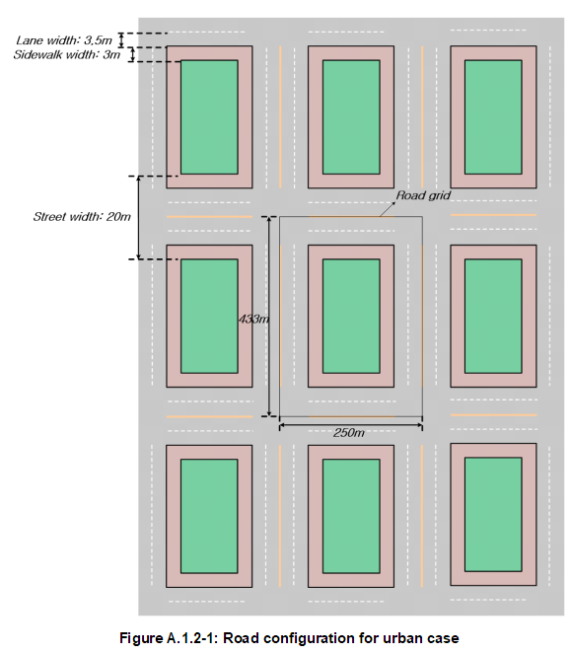
Create Road(Urban case)
Notes:
3GPP TR 36.885 V14.0.0 (2016-06) p64
Figure A.1.2-1:Road configuration for urban case

Slide 8

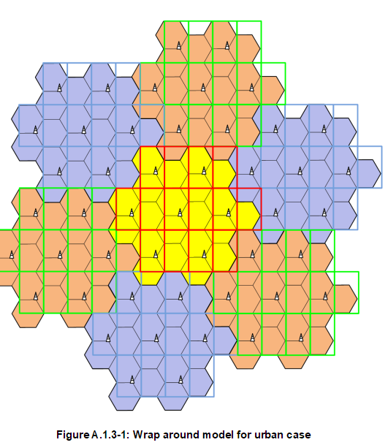
Drop vehicle, base station (Urban case)
Vehicle UEs are dropped on the roads according to spatial Poisson process.
Vehicle density is determined by the vehicle speed
macro eNB is 500 m and the wrap around model in
Figure A.1.3-1 is used.
Notes:
3GPP TR 36.885 V14.0.0 (2016-06) p65, p66
Figure A.1.3-1 : Wrap around model for urban case

Slide 9
Set vehicle UE’s state
Vehicle No. | Absolute vehicle speed
0 | 15 km/h or 60 km/h
1 | 15 km/h or 60 km/h
... | 15 km/h or 60 km/h
N | 15 km/h or 60 km/h
Notes:
3GPP TR 36.885 V14.0.0 (2016-06) p64
Table A.1.2-1: Details of vehicle UE drop and mobility model

Slide 10
Set vehicle UE’s state
Notes:
3GPP TR 36.885 V14.0.0 (2016-06) p64
Table A.1.2-1: Details of vehicle UE drop and mobility model

Slide 11
Initialize V2V(Vehicle to Vehicle) link
No. 1
N ：Number of vehicles
R : Number of Resource block
1. Large scale fading
- Shadow fading (NxN matrix)
- Pathloss (NxN matrix)
2. Small scale fading
- Fast fading (NxNxR matrix)
No. 0
No. 2
Notes:
3GPP TR 36.885 V14.0.0 (2016-06) p64
Table A.1.2-1: Details of vehicle UE drop and mobility model

Slide 12
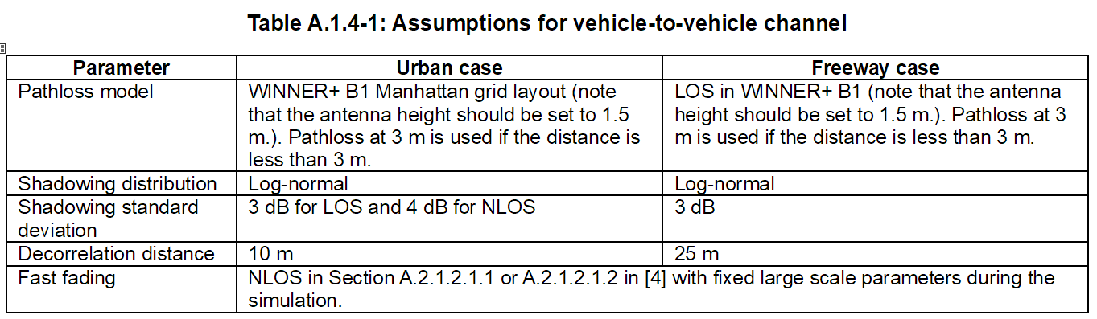
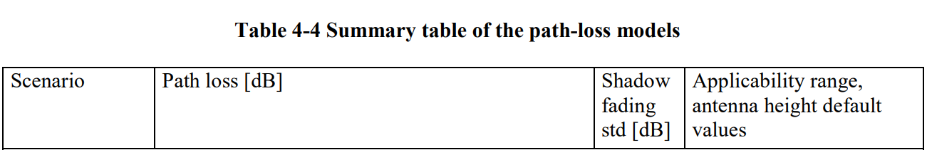
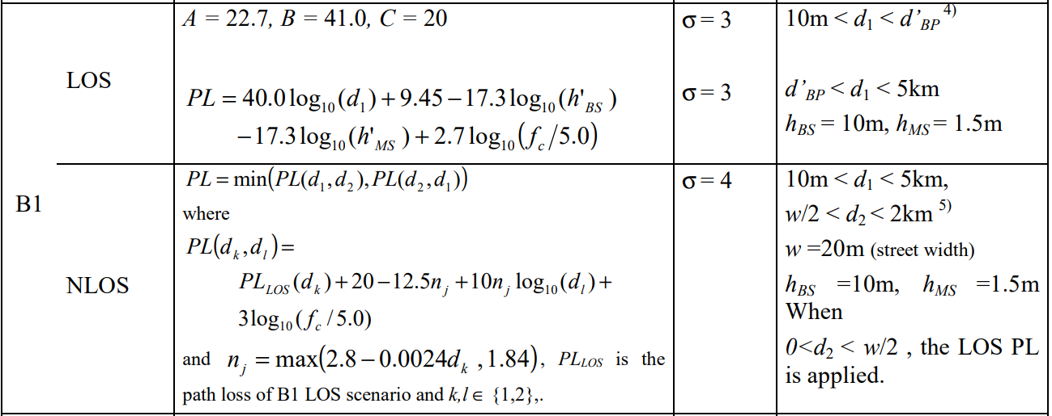
Initialize V2V(Vehicle to Vehicle) link
3GPP 36.885
Release 14
WINNER+ B1
Manhattan grid layout
Notes:
3GPP TR 36.885 V14.0.0 (2016-06) p7 Table A.1.4-1: Assumptions for vehicle-to-vehicle channel
WINNER II channel models (Febuary 2008) Page 44 Table 4-4 Summary table of the path-loss models

Slide 13

Initialize V2V(Vehicle to Vehicle) link
Large scale fading(N : Number of vehicles )
- Shadow fading (NxN matrix)
$$Shadowing matrix : \left[\begin{matrix}s_{0 0} & ⋯ & s_{0 N} \\ ⋮ & ⋱ & ⋮ \\ s_{N 0} & ⋯ & s_{N N}\end{matrix}\right]$$
$$s_{i j} : i번째 차량에서 j번째 차량으로 전송할때 Shadow fading$$
$${ s}_{i j} \sim ln𝒩(0,σ^{2}), σ = 3dB for LOS or σ = 4dB for LOS$$
Notes:
WINNER II channel models (Febuary 2008) Page 44 Table 4-4 Summary table of the path-loss models

Slide 14
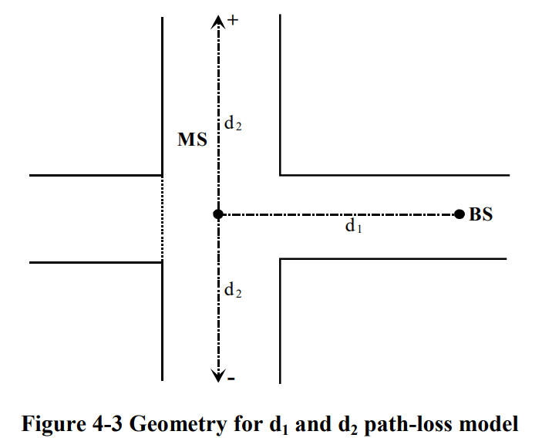

Initialize V2V(Vehicle to Vehicle) link
Large scale fading(N : Number of vehicles )
- Pathloss model (NxN matrix)
$$Pathloss matrix : \left[\begin{matrix}p_{0 0} & ⋯ & p_{0 N} \\ ⋮ & ⋱ & ⋮ \\ p_{N 0} & ⋯ & p_{N N}\end{matrix}\right]$$
$$p_{i j} : i번째 차량에서 j번째 차량으로 전송할때 Pathloss$$
$${ p}_{i j} = \left\{\begin{aligned}if LOS(d ≥ 3m){ 40.0log}_{10}(d){+ 9.45−17.3\log_{10}({h′}_{bs}){−17.3\log_{10}({h′}_{ms}){+2.7\log_{10}(f_{c}/5.0){ }}}} \\ if LOS(d < 3m){ 22.7log}_{10}(d){+ 41.0+20\log_{10}(f_{c}/5.0){ }{}} \\ if NLOS min({PL}_{NLOS}(d_{1},d_{2}), {PL}_{NLOS}(d_{1},d_{2})) \end{aligned}\right.$$
$${PL}_{LOS} is the pathloss of LOS scenario and k,l∈\{1,2\}$$
$${{PL}_{NLOS}(d_{k},d_{l}) : PL}_{LOS}(d_{k})+20−12.5n_{j}+10n_{j}\log_{10}(d_{l}){+3\log_{10}(f_{c}/5.0){}}$$
$$n_{j} : max(2.8−0.0024d_{k}, 1.84)$$
$$d : 두차량의 대각 거리$$
$$d1 : 송신 차량에서 교차로 까지 거리$$
$$d2 : 수신 차량에서 교차로 까지 거리$$
$$f_{c} : Carrier frequency$$
$${h′}_{bs} : 송신 차량의 안테나 높이 - 1$$
$${h′}_{ms}: 수신 차량의 안테나 높이 - 1$$
Notes:
WINNER II channel models (Febuary 2008) Page 44 Table 4-4 Summary table of the path-loss models

Slide 15

Initialize V2V(Vehicle to Vehicle) link
Small scale fading(N : Number of vehicles , R : Resource block )
- Fast fading (NxNxR matrix)
(Fast fading은 position의 영향을 받지 않음.)
$$Fast fading matrix : \left[\begin{matrix}\left[\begin{aligned}{rb}_{0,0,0} \\ ⋮ \\ {rb}_{0,0,R}\end{aligned}\right] & ⋯ & \left[\begin{aligned}{rb}_{0,N,0} \\ ⋮ \\ {rb}_{0,N,R}\end{aligned}\right] \\ ⋮ & ⋱ & ⋮ \\ \left[\begin{aligned}{rb}_{N,0,0} \\ ⋮ \\ {rb}_{N,0,R}\end{aligned}\right] & ⋯ & \left[\begin{aligned}{rb}_{N,N,0} \\ ⋮ \\ {rb}_{N,N,R}\end{aligned}\right]\end{matrix}\right]$$
$${rb}_{i,j,r} : i번째 vehicle에서$$
$$j 번째 vehicle로$$
$$r번째 resource block을 통해$$
$$신호를 전송할때 발생하는 fast fading 값$$
$$(자기 자신은 0으로 설정)$$
Notes:
3GPP TR 36.843 V12.0.1 (2014-03)
DDPG-Based Resource Allocation Scheme for NOMA Vehicular Communications 논문 : Fast fading을 Reyleigh fading을 사용.
Deep Reinforcement Learning Based Resource Allocation for V2V Communications 논문 : 실수부와 허수부를 독립적으로 가우시안 distrubution을 사용.
Reyleigh fading WIKI : https://ko.wikipedia.org/wiki/%EB%A0%88%EC%9D%BC%EB%A6%AC_%ED%8E%98%EC%9D%B4%EB%94%A9

Slide 16
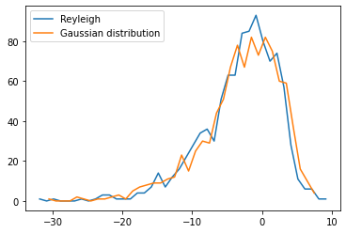


Initialize V2V(Vehicle to Vehicle) link
Small scale fading(N : Number of vehicles , R : Resource block )
Fast fading method
1. Deep Reinforcement Learning Based Resource Allocation for V2V Commnunications 논문
-> Gaussian distrubution method
2. DDPG-Based Resource Allocation Scheme for NOMA Vehicular Communications 논문
-> Reyleigh fading method
$$a \sim 𝒩(0,σ^{2}), σ = 1$$
$$b \sim 𝒩(0,σ^{2}), σ = 1$$
$$Fastfading dBm = 20\log_{10}{\frac{1}{\sqrt{2}}(abs(a + jb))}$$
$$SNR dBm from Reyleigh fading CDFS$$
$$γ ={−\overline{γ}}_{k}(\ln{(1−F_{γ_{k}}\left(x\right))}$$
$$F_{γ_{k}}\left(x\right) : 0 \sim 1 사이의 랜덤 값$$
$${\overline{γ}}_{k} : 평균 SNR dBm$$
Notes:
3GPP TR 36.843 V12.0.1 (2014-03)
DDPG-Based Resource Allocation Scheme for NOMA Vehicular Communications 논문 : Fast fading을 Reyleigh fading을 사용.
Deep Reinforcement Learning Based Resource Allocation for V2V Communications 논문 : 실수부와 허수부를 독립적으로 가우시안 distrubution을 사용.
Reyleigh fading WIKI : https://ko.wikipedia.org/wiki/%EB%A0%88%EC%9D%BC%EB%A6%AC_%ED%8E%98%EC%9D%B4%EB%94%A9

Slide 17
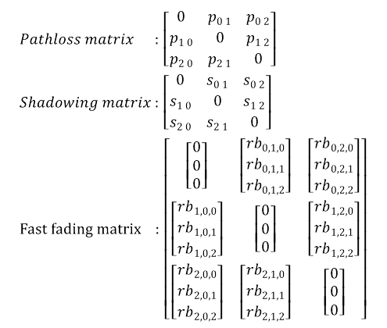


Overall V2V(Vehicle to Vehicle) link
Number of vehicles : 3
Resource block: 3
No. 1
$$Pathloss matrix : \left[\begin{matrix}0 & p_{0 1} & p_{0 2} \\ p_{1 0} & 0 & p_{1 2} \\ p_{2 0} & p_{2 1} & 0\end{matrix}\right]$$
$$Shadowing matrix : \left[\begin{matrix}0 & s_{0 1} & s_{0 2} \\ s_{1 0} & 0 & s_{1 2} \\ s_{2 0} & s_{2 1} & 0\end{matrix}\right]$$
$$Fast fading matrix : \left[\begin{matrix}\left[\begin{aligned}0 \\ 0 \\ 0\end{aligned}\right] & \left[\begin{aligned}{rb}_{0,1,0} \\ {rb}_{0,1,1} \\ {rb}_{0,1,2}\end{aligned}\right] & \left[\begin{aligned}{rb}_{0,2,0} \\ {rb}_{0,2,1} \\ {rb}_{0,2,2}\end{aligned}\right] \\ \left[\begin{aligned}{rb}_{1,0,0} \\ {rb}_{1,0,1} \\ {rb}_{1,0,2}\end{aligned}\right] & \left[\begin{aligned}0 \\ 0 \\ 0\end{aligned}\right] & \left[\begin{aligned}{rb}_{1,2,0} \\ {rb}_{1,2,1} \\ {rb}_{1,2,2}\end{aligned}\right] \\ \left[\begin{aligned}{rb}_{2,0,0} \\ {rb}_{2,0,1} \\ {rb}_{2,0,2}\end{aligned}\right] & \left[\begin{aligned}{rb}_{2,1,0} \\ {rb}_{2,1,1} \\ {rb}_{2,1,2}\end{aligned}\right] & \left[\begin{aligned}0 \\ 0 \\ 0\end{aligned}\right]\end{matrix}\right]$$
$$p_{0 1},s_{0 1}, {rb}_{0,1,0}$$
No. 0
$$p_{1,0},{ s}_{1,0}, { rb}_{1,0,1}$$
No. 2
Notes:
3GPP TR 36.843 V12.0.1 (2014-03)
DDPG-Based Resource Allocation Scheme for NOMA Vehicular Communications 논문 : Fast fading을 Reyleigh fading을 사용.
Deep Reinforcement Learning Based Resource Allocation for V2V Communications 논문 : 실수부와 허수부를 독립적으로 가우시안 distrubution을 사용.
Reyleigh fading WIKI : https://ko.wikipedia.org/wiki/%EB%A0%88%EC%9D%BC%EB%A6%AC_%ED%8E%98%EC%9D%B4%EB%94%A9

Slide 18
Initialize V2I(Vehicle to Infrastructure) link
No. 1
N ：Number of vehicles
R : Number of Resource block
1. Large scale fading
- Shadow fading (N matrix)
- Pathloss (N matrix)
2. Small scale fading
- Fast fading (NxR matrix)
No. 0
No. 2
Notes:
3GPP TR 36.843 V12.0.1 (2014-03)
DDPG-Based Resource Allocation Scheme for NOMA Vehicular Communications 논문 : Fast fading을 Reyleigh fading을 사용.
Deep Reinforcement Learning Based Resource Allocation for V2V Communications 논문 : 실수부와 허수부를 독립적으로 가우시안 distrubution을 사용.
Reyleigh fading WIKI : https://ko.wikipedia.org/wiki/%EB%A0%88%EC%9D%BC%EB%A6%AC_%ED%8E%98%EC%9D%B4%EB%94%A9

Slide 19
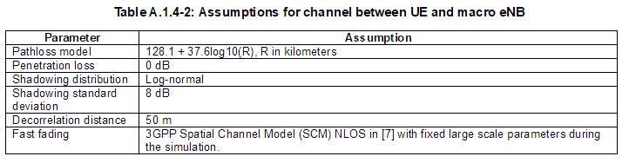
Initialize V2I(Vehicle to Infrastructure) link
Notes:
3GPP TR 36.843 V12.0.1 (2014-03) Table A.1.4-2

Slide 20

Initialize V2I(Vehicle to Infrastructure) link
Large scale fading(N :차량의 수 )
- Shadow fading (N matrix)
$$Shadowing matrix : \left[\begin{matrix}s_{0} \\ ⋮ \\ s_{N}\end{matrix}\right]$$
$$s_{i } : i번째 차량과 eNodeB link에서 생성된 Shadow fading$$
$${ s}_{i } \sim ln𝒩(0,σ^{2}), σ = 8dB$$
Notes:
3GPP TR 36.843 V12.0.1 (2014-03) Table A.1.4-2

Slide 21


Initialize V2I(Vehicle to Infrastructure) link
Large scale fading(N :차량의 수 )
- Pathloss model (N matrix)
$$Pathloss matrix : \left[\begin{matrix}p_{0} \\ ⋮ \\ p_{N}\end{matrix}\right]$$
$$p_{i j} : i번째 차량과 eNodeB간의 link에서 생성된 Pathloss$$
$${ p}_{i j} = { 128.1 + 37.6log}_{10}(d/km){}$$
$$d$$
Notes:
WINNER II channel models (Febuary 2008) Page 44 Table 4-4 Summary table of the path-loss models

Slide 22

Initialize V2I(Vehicle to Infrastructure) link
Small scale fading(N :차량의 수,R : Resource block )
- Fast fading (NxR matrix)
(Fast fading은 position의 영향을 받지 않음.)
1. Deep Reinforcement Learning Based Resource Allocation for V2V Commnunications 논문
-> Gaussian distrubution method(V2V Link와 동일한 계산 공식)
2. DDPG-Based Resource Allocation Scheme for NOMA Vehicular Communications 논문
-> Reyleigh fading method(V2V Link와 동일한 계산 공식)
$$Fast fading matrix : \left[\begin{matrix}{rb}_{0,0} & … & {rb}_{0,R} \\ ⋮ & ⋱ & ⋮ \\ {rb}_{N,0} & … & {rb}_{N,R}\end{matrix}\right]$$
$${rb}_{i,j} : i번째 vehicle에서 j 번째 resource block을 통해$$
$$신호를 전송할때 발생하는 fast fading 값$$
$$(자기 자신은 0으로 설정)$$
Notes:
WINNER II channel models (Febuary 2008) Page 44 Table 4-4 Summary table of the path-loss models

Slide 23

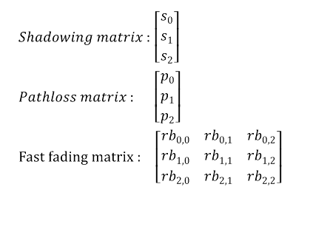
Overall V2I(Vehicle to Infrastructure) link
Number of vehicles : 3
Resource block: 3
eNodeB : 1
No. 1
$$p_{0 }, s_{0 }, {rb}_{0,1}$$
$$Shadowing matrix : \left[\begin{matrix}s_{0} \\ s_{1} \\ s_{2}\end{matrix}\right]$$
$$Pathloss matrix : \left[\begin{matrix}p_{0} \\ p_{1} \\ p_{2}\end{matrix}\right]$$
$$Fast fading matrix : \left[\begin{matrix}{rb}_{0,0} & {rb}_{0,1} & {rb}_{0,2} \\ {rb}_{1,0} & {rb}_{1,1} & {rb}_{1,2} \\ {rb}_{2,0} & {rb}_{2,1} & {rb}_{2,2}\end{matrix}\right]$$
No. 0
No. 2

Slide 24
Update(time step 100ms)
3 차량, 1 eNodeB
No. 1
No. 1
No. 0
No. 0
No. 2
No. 2
t0
100ms
t1

Slide 25
Update(time step 100ms)
V2V link , V2I link
- Pathloss matrix update
V2V, V2I link에 Initialize 공식
- Fast fading matrix
V2V, V2I link에 Initialize 공식
Notes:
3GPP TR 36.885 V14.0.0 (2016-06)

Slide 26



Update(time step 100ms)
V2V link Shadowing matrix
V2I link Shadowing matrix
$$S(n)=e^{\frac{-D}{D_corr}} ×S(n-1)×\sqrt{1-e^{\frac{-2D}{D_corr}}}×N_S(n)$$
$$S\left(n\right) : Next step Shadowing$$
$$D : Delta distance (m)$$
$$D_corr : 10 (m)$$
$$S(n-1) : Current step Shadowing$$
$$N_S(n) : n𝒩(0,σ^{2}), σ = 3dB for LOS or σ = 4dB for LOS$$
$$Delta distance (m)$$
$$S(n)=e^{\frac{-D}{D_corr}} ×S(n-1)×\sqrt{1-e^{\frac{-2D}{D_corr}}}×N_S(n)$$
$$S\left(n\right) : Next step Shadowing$$
$$D : Delta distance (m)$$
$$D_corr : 50 (m)$$
$$S(n-1) : Current step Shadowing$$
$$N_S(n) : n𝒩(0,σ^{2}), σ = 8dB$$
Notes:
3GPP TR 36.885 V14.0.0 (2016-06)

Slide 27
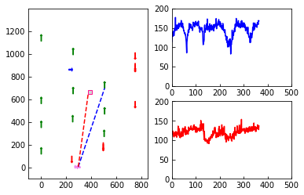
ANALYSYS
Graph description.
Manhattan grid map
loss dB
V2V link combine loss
position Y
BS
loss dB
V2I link combine loss
1step(0.1ms)
V2V link
V2I link
MS(Vehicle)
position X
1step(0.1ms)
Notes:
3GPP TR 36.885 V14.0.0 (2016-06)

Slide 28
ANALYSYS
Compare V2V, V2I link
Notes:
3GPP TR 36.885 V14.0.0 (2016-06)

Slide 29
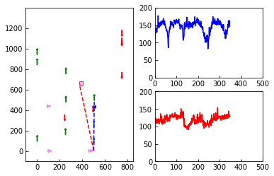
ANALYSYS
Compare V2V, V2I link
두 차량의 거리가 멀어 질수록 V2V Link의 Loss는 증가
기지국과의 거리가 일정함으로 V2I Link는 Loss는 유지
Notes:
3GPP TR 36.885 V14.0.0 (2016-06)

Slide 30
ANALYSYS
Compare V2V, V2I link
두 차량의 거리가 멀어 질수록 V2V Link의 Loss는 증가
기지국과의 거리가 일정함으로 V2I Link는 Loss는 유지
Notes:
3GPP TR 36.885 V14.0.0 (2016-06)

Slide 31
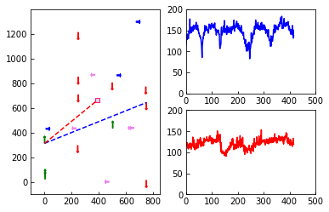
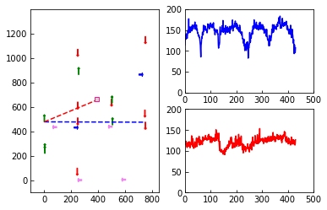
ANALYSYS
Compare V2V, V2I link
두 차량의 V2V Link가 LOS 환경을 만족 시키면
Loss 급격히 감소
Notes:
3GPP TR 36.885 V14.0.0 (2016-06)

Slide 32
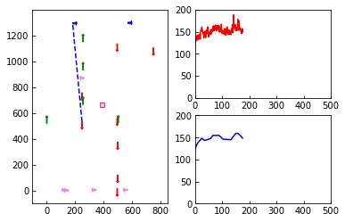
ANALYSYS
Analysis of the effect of WINNER II Path loss.
Manhattan grid map
loss dB
V2V link combine loss
position Y
MS(Vehicle)
V2V link
BS
loss dB
V2V link WINNER II Path loss
1step(0.1ms)
position X
1step(0.1ms)
Notes:
3GPP TR 36.885 V14.0.0 (2016-06)

Slide 33
ANALYSYS
Analysis of the effect of path loss.
Notes:
3GPP TR 36.885 V14.0.0 (2016-06)

Slide 34
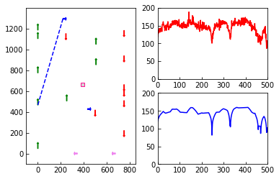
ANALYSYS
Analysis of the effect of path loss.
V2V link의 Loss는 Pathloss의 영향이 대부분을 차지.
Notes:
3GPP TR 36.885 V14.0.0 (2016-06)

Slide 35
Development Environment
Win10 Pro x64
Anaconda
Python 3.7.3 Version
Pytorch 1.8.0
Pandas 1.2.3
Matplotlib 3.3.4
Numpy 1.19.2

Slide 36
Reference
[1] Neural Networks and Deep Learning, Charu C. Aggarwal
[2] Throughput Analysis of Proportional Fair Scheduling, Jaewoo So, Senior Member, IEEE
[3] 밑바닥 부터 시작하는 딥러닝, 사이토 고키, 한빛미디어
[4] PyTorch를 활용한 강화학습/심층강화학습 실전 입문, 오가와 유타로, 위키북스
[5] Logistic Regression, http://hleecaster.com/ml-logistic-regression-concept/
[6] How to Choose Loss Functions When Training Deep Learning Neural Networks
, https://machinelearningmastery.com/how-to-choose-loss-functions-when-training-deep-learning-neural-networks/
[7] Probability Density Functions (PDFs) and Cumulative Distribution Functions (CDFs) for Continuous Random Variables, https://stats.libretexts.org/Courses/Saint_Mary's_College_Notre_Dame/MATH_345__-_Probability_(Kuter)/4%3A_Continuous_Random_Variables/4.1%3A_Probability_Density_Functions_(PDFs)_and_Cumulative_Distribution_Functions_(CDFs)_for_Continuous_Random_Variables

